Slide 1
Secure Modem
Hardware Design - The Vocoder

Slide 2
Content
Vocoder Overview
Vocoder in Radio Modem
AMBE Vocoder
Summary
Discussion

Slide 3
Vocoder Overview
What is Vocoder
History of Vocoder
How Vocoder Works
Vocoder Application

Slide 4
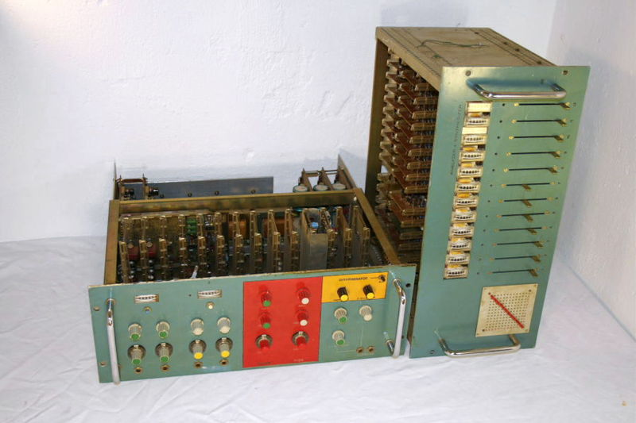
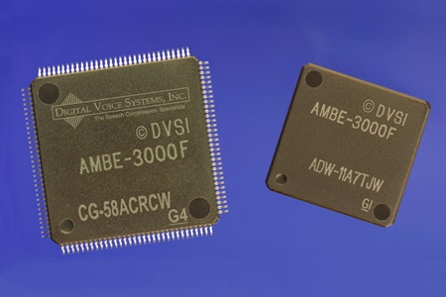
Vocoder Description
Early 1970s electronic music vocoder
The vocoder is an electronic device that analyzes the human voice, breaking it up into its component parts
The voder is a similar device that synthesizes a human voice
More often than not, vocoder and voder are combined in one unit
Vocoder chips
Notes:
Source:
http://www.ieeeghn.org/wiki/index.php/Vocoders_and_Voders

Slide 5
History of Vocoder
Motivation:
  Bandwidth restrictions for transmission of a complete human speech
  Potential for undesirable eavesdropping in traditional analog devices
In response to those issues:
  Homer W. Dudley devised a system for vocal communication while working at Bell Labs
  Described in detail in his 1935 patent application was the device known as the vocoder
Notes:
Source:
http://community.wvu.edu/~ndw010/projects/vocoder/

Slide 6
How Vocoder Works
Encoder
  Speech waveform is passed through a parallel bank of BPF
  After BPF, the filtered signal is passed to envelope follower to approximate the average amplitude of that band
  BPF and envelope follower produce a rough frequency spectrum of speech waveform
  Fundamental detector detects instantaneous fundamental frequency of speech signal
  All those signals are combined to produce an encoded speech waveform
Simplified block diagram of voice encoder
Notes:
Source:
http://community.wvu.edu/~ndw010/projects/vocoder/

Slide 7
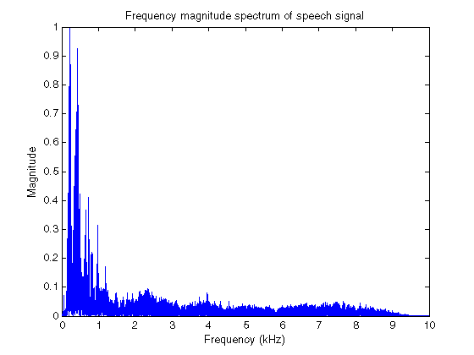
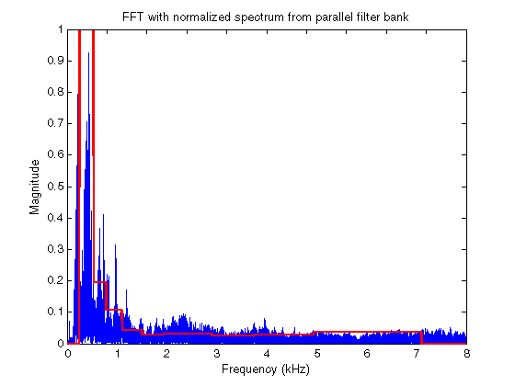
How Vocoder Works 1
Norm. freq. spectrum of a female speech signal fs = 44.1kHz
Comparison of FFT spectra and filter output

Slide 8
How Vocoder Works 2
Decoder
  The incoming signal is demultiplexed and each signal is routed to the appropriate block
  Signal representing fundamental freq. is routed to VCO, which generates a waveform at fundamental freq.
  This waveform then mixed with white noise signal and passed to BPFs
Simplified block diagram of voice decoder
Notes:
Source:
http://community.wvu.edu/~ndw010/projects/vocoder/

Slide 9
How Vocoder Works 3
Decoder Cont.
  The incoming signal representing the band levels, each drive the gain of one of VCA at the output of each filter
  Each of the outputs are then mixed together to produce resynthesized speech signal

Slide 10
Vocoder Application
Digital voice scrambling and encryption
VoIP system
Artistic musical effect
Cochlear implants
Etc.

Slide 11
Vocoder in Radio Modem
Commercial Radio Modem
Vocoder

Slide 12
Commercial Radio Modem
AOR ARD9900
  Digital data and voice over analog radio
  Using AMBE2020 vocoder
  Interfacing TX/RX (MIC and SP)

Slide 13
AMBE VOCODER
AMBE 2020 Chip
AMBE 3030 Chip

Slide 14
Summary

Slide 15
Discussion

